Slide 1
UNIX SYSTEM PROGRAMMING
FILE IO

Slide 2
Components of file system
Boot Block | Super Block | Inode Blocks | Data Blocks
Boot block:
Contains boot strap code.
Super block:
Stores File system information.
Inode list:
Stores basic information about files.
Data block:
Stores the actual data of file.

Slide 3
Super Block
The Super block describes the state of the file system.
Super Block consists of:
Size of the file system
No. of free blocks in the file system
List of free blocks available in the file system
Index of the next free block in the free block list
Size of the i-node list
No. of free i-nodes in the file system
Index of the next free i-node in the file system
Notes:
http://www.cs.rutgers.edu/~pxk/416/notes/13-fs-studies.html
<number>

Slide 4
inode
Contains the information necessary for a process to access a file.
Exists in static form on the disk.
Struct inode contains following info:
File ownership
File type and access permissions
Time stamp: Creation time, Modification time, last access
Hard link count
File size
Address of data blocks associated with the file.
(Array of 13 pointers)
These inodes are also called as disk inodes
Notes:
http://www.cs.rutgers.edu/~pxk/416/notes/13-fs-studies.html
<number>

Slide 5
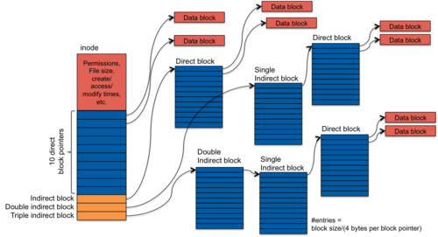
Inode structure

Slide 6
Inode
When a process accesses a file, kernel reads the file’s inode into an in–core inode.

Slide 7
Incore inode vs disk inode
Kernel maintains an in-core list for maintaining currently opened inodes.
The In-core I-node contains the usual info of a disk inode in addition to the following:
Status of in-core inode : locked .
Logical device # of file system
The inode no.
Pointers to other in-core inodes
Reference Count
Notes:
http://www.mywbut.com/answer-details.php?question_id=1400
<number>

Slide 8
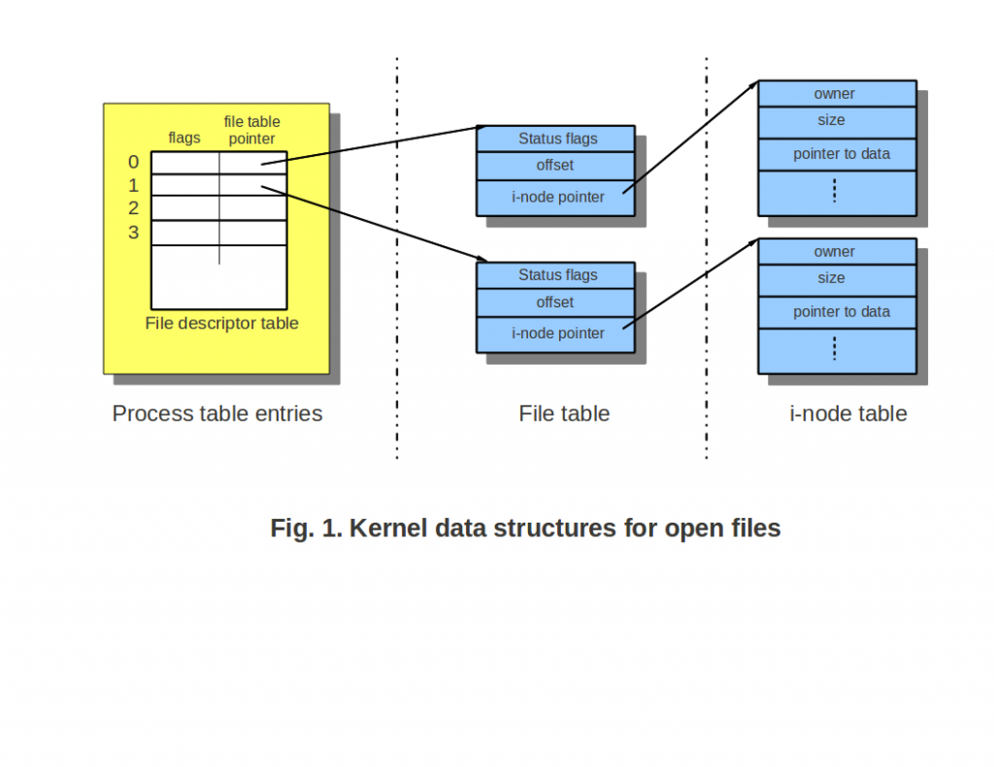

Slide 9
Block num = ((inode no – 1) / number of inodes per block) + start block of inode list.
Byte offset ((inode no -1 ) % number of inodes per block) * sizeof inode structure.
Inode no = 222
Number of inodes per block = 16
Start block of inode list = 128.
Block num = ((222 – 1) / 16 ) + 128.
= 141
Byte offset ((inode no -1 ) % number of inodes per block) * sizeof inode structure.

Slide 10
File Related System Calls
int open(const char *pathname , int flag);
Macro | Description
O_RDONLY | One of these is must
O_WRONLY
O_RDWR
O_APPEND | These are optional.
O_TRUNC
O_CREAT
Open an non-existing file in readonly mode and check the return value.
Open an existing file in readonly mode and check the return value.
Open an non-existing file in writeonly mode and check the return value.
Open an existing file in writeonly mode and check the return value.
Check if the existing data in file is deleted or not.
Notes:
Open_read.c – Opens a file in read mode.
-1
3
open_write.c
-1 File opening will fail.
3
(existing data contents are retained).
New data will overwrite old data
Existing Data : CRANES VARSITY
New Data : fd = open(“test.txt”,O_WRONLY);
write(fd,”ABCD”,4);
Final data: ABCDES VARSITY
5.
<number>

Slide 11
File Related System Call : Read
ssize_t read(int fd, void *buf, size_t count);
Return value : 0 – EOF, -1 Error ,
Success : >0 but <= count
Write a program to open a file in read mode and read the contents from file and display on monitor?
while((len = read(fd , str , SIZE)) > 0)
{
str[len] = ‘\0’;
puts(str);
}
Notes:
Open_readdata.c
char str[40] = "";
while(read(fd , str , 39) > 0)
{
puts(str);
memset(str , 0 , 40); / str[40] = ‘\0’;
}
<number>

Slide 12
File Related System Call : write
ssize_t write(int fd, void *buf, size_t count);
Return value :
0 – Nothing was written
-1 – Error
Success : >0 (number of bytes written)
Write a program to read data from stdin and write to file.
int fd = open(argv[1] , O_WRONLY);
char str[40] = "";
while(fgets(str , 39,stdin) != NULL)
{
write(fd , str , 39);
}
Notes:
Open_writedata.c
<number>

Slide 13
File Related System Calls
How to create a new file.
Macro
O_RDONLY
O_WRONLY
O_RDWR
O_APPEND
O_TRUNC
O_CREAT
open(“newfile.txt" , O_WRONLY | O_CREAT);
What happens if you open an existing file with O_WRONLY | O_CREAT mode. The contents will be retained or deleted
How to write data at end of file.
open(“append.txt" , O_WRONLY | O_APPEND);
How to clear the contents of file.
open(argv[1] , O_WRONLY | O_TRUNC);
Notes:
Open_creat.c
What happens if you open an existing file with O_WRONLY | O_CREAT mode. The contents will be retained or deleted
Contents will be retained, writing will begin from offset 0 (overwrite existing data)
How to write data at end of file.
open("test1.txt" , O_WRONLY | O_APPEND);
open(argv[1] , O_WRONLY | O_TRUNC);
<number>

Slide 14
File Related System Calls
int open(const char *pathname, int flags, mode_t mode);
Mode – File permissions
Specify the mode value in hex like 0666 etc, and verify if the specified permissions are set for file
Mode & ~umask
Notes:
To see user mask value($umask)
Mode & ~umask
<number>

Slide 15
File Related System Calls
int creat(const char *pathname, mode_t mode);
creat opens file for write only.
similar to
open (pathname, O_WRONLY | O_CREAT | O_TRUNC, mode);
Mode – File permissions
int close(int filedescriptor);
Notes:
creat.c
<number>

Slide 16
What will be the fd value (output).
void func()
{
int fd = open("test1.txt" , O_WRONLY);
printf(" %d " , fd);
}
int main()
{
func();
func();
}
Notes:
Close.c
Note : Pass an existing file OR
open(“file”, O_WRONLY | O_CREAT , 0666);
Close(fd); in function
<number>

Slide 17
Write a program to implement cp command
$cp sourcefile destinationfile
Open source file in readmode
Open destination file in write mode.
Read data from source file and write to dest file.
Notes:
Open destination file in write mode + Create + Trunc
<number>

Slide 18
Write a program to implement cat command
$cat filename
Open source file in readmode
Set stdout as the destfile (fd = 1)
Read data from source file and write to dest file.
Notes:
<number>

Slide 19
Implement cat command.
$cat
Read descriptor – 0
Write descriptor - 1
fdr = 0;
fdw = 1;
Notes:
/* Pgm to implement cat (stdin -> stdout) */
#include <stdio.h>
#include <sys/types.h>
#include <sys/stat.h>
#include <fcntl.h>
int main(int argc,char *argv[])
{
int fdw = 1; //open(argv[1] , O_WRONLY | O_CREAT , 0664);
int fdr = 0;
char str[40];
int len;
do
{
memset(str , 0 , 40);
if(read(fdr , str , 39) == 0)
break;
len = strlen(str);
if(write(fdw , str , len) != len)
{
printf("Unable to write");
break;
}
}while(1);
close(fdr);
close(fdw);
}
<number>

Slide 20
Implement cat command.
$cat outfile
Read descriptor – 0
Write descriptor – return value of open function.(>= 3)
Notes:
Mycat.c
/* Pgm to implement cat : stdin to file( cat outfile) */
#include <stdio.h>
#include <sys/types.h>
#include <sys/stat.h>
#include <fcntl.h>
int main(int argc,char *argv[])
{
if(argc != 2)
{
printf("Wrong no. of arguments ");
return 1;
}
int fdr = 0;
int fdw = open(argv[1] , O_WRONLY | O_CREAT , 0664);
char str[40];
int len;
do
{
memset(str , 0 , 40);
if(read(fdr , str , 39) == 0)
break;
len = strlen(str);
if(write(fdw , str , len) != len)
{
printf("Unable to write");
break;
}
}while(1);
close(fdr);
close(fdw);
}
<number>

Slide 21
Implement cat command:Input file to stdout.
$cat inpfile
Write descriptor– 1
Read descriptor – return value of open function.(>= 3)
Notes:
/* Pgm to implement cat : file to stdout ( cat inputfile) */
#include <stdio.h>
#include <sys/types.h>
#include <sys/stat.h>
#include <fcntl.h>
int main(int argc,char *argv[])
{
if(argc != 2)
{
printf("Wrong no. of arguments ");
return 1;
}
int fdw = 1;
int fdr = open(argv[1] , O_RDONLY);
if(fdr == -1)
{
perror("Wrong inputfile");
return 1;
}
char str[40];
int len;
do
{
memset(str , 0 , 40);
if(read(fdr , str , 39) == 0)
break;
len = strlen(str);
if(write(fdw , str , len) != len)
{
printf("Unable to write");
break;
}
}while(1);
close(fdr);
close(fdw);
}
<number>

Slide 22
lseek
off_t lseek(int fildes, off_t offset, int whence);
What happens if offset is greater than the size of file.
The lseek function allows the file offset to be set beyond the end of the exist-ing end-of-file of the file
Notes:
printf("Enter the offset : ");
scanf(" %d",&n);
lseek(fdr , n , SEEK_SET);
do
{
memset(str , 0 , 40);
if(read(fdr , str , 39) == 0)
break;
len = strlen(str);
if(write(fdw , str , len) != len)
{
printf("Unable to write");
break;
}
}while(1);
<number>

Slide 23
Can Multiple File Descriptors point to same File Table? (Yes)
Every open adds a new entry in FDT and FT.
Demonstration using multiple open sys call and checking the return values (eg: 3 and 4).

Slide 24
#include <fcntl.h>
int main(int argc,char *argv[])
{
int fd1 = open(argv[1] , O_RDONLY);
int fd2 = open(argv[1] , O_RDONLY);
/* Reading first 10 characters using descriptor 1 */
char str1[20] = "";
char str2[20] = "";
read(fd1 , str1 , 10);
printf("str1 = %s \n",str1);
/* Reading first 10 characters using descriptor 2 “ */
read(fd2 , str2 , 10);
printf("str2 = %s \n",str2);
close(fd1);
close(fd2);
}
Notes:
Predupread.c
<number>

Slide 25
#include <fcntl.h>
int main(int argc,char *argv[])
{
int fd1 = open(argv[1] , O_WRONLY | O_CREAT , 0666);
int fd2 = open(argv[1] , O_WRONLY);
char str1[20] = "CRANES";
char str2[20] = "VARSITY";
write(fd1 , str1 , 10);
write(fd2 , str2 , 10);
close(fd1);
close(fd2);
}
Notes:
Second Write overwrites first one.
<number>

Slide 26
Open
3
4

Slide 27
Dup
Dup System call is used to Create a copy (or duplicate) of file descripter
int dup(int oldfd);
dup uses the lowest-numbered unused descriptor for the new descriptor.
int dup2(int oldfd,int new fd);
dup2 makes newfd be the copy of oldfd, closing newfd first if necessary.
Notes:
1 #include <sys/types.h>
2 #include <sys/stat.h>
3 #include <fcntl.h>
4 void testdup();
5 void testdup2();
6 int main()
7 {
8 testdup();
9 testdup2();
10 }
11 void testdup()
12 {
13 printf("\n TESTING DUP \n");
14 int fd;
15
16 fd = open("test1.txt" , O_WRONLY);
17 printf("fd = %d \n" , fd);
18 int newfd = dup(fd);
19 printf("new fd = %d \n" , newfd);
20
21 }
22
23 void testdup2()
24 {
25 printf("\n TESTING DUP2 \n");
26 int fd = open("test1.txt" , O_WRONLY);
27 printf("fd = %d \n" , fd);
28 int newfd = dup2(fd , 8);
29 printf("new fd = %d \n" , newfd);
30 printf("\n %d \n" , open("test1.txt" , O_RDONLY));
31
32 }
<number>

Slide 28
Difference Between Dup and Open
int main()
{
int oldfd = open("file.txt" , O_WRONLY);
int newfd;
printf("Old fd = %d \n" , oldfd);
newfd = open("file.txt" , O_WRONLY);
printf("New fd = %d \n" , newfd);
}
int main()
{
int oldfd = open("file.txt" , O_WRONLY);
int newfd;
printf("Old fd = %d \n" , oldfd);
newfd = dup(oldfd);
printf("New fd = %d \n" , newfd);
}

Slide 29
Dup
3
4

Slide 30
IOREDIRECT
Making scanf read from file
Open a file in read mode
Close input file descriptor (close(0))
Dup to make newfd refer to 0
int main()
{
int fd = open("test1.txt" , O_RDONLY);
close(0);
int newfd = dup(fd); //0 will be the newfd
char str[20] = "";
printf("Enter a string : ");
scanf("%s", str); //Reads from file
printf("str = %s",str);
}
int newfd = dup2(fd,0);
Notes:
<number>

Slide 31
IOREDIRECT
Making printf write to file
Open a file in write mode
Close output file descriptor (close(0))
Dup to make newfd refer to 1
int main(int argc, char *argv[] )
{
int fd= open(argv[1] , O_WRONLY | O_TRUNC | O_CREAT , 0666);
close(1);
int newfd = dup(fd); //As fd 1 is closed, 1 will be the newfd
printf( "SIKANDER " ); //Prints to file
}
int newfd = dup2(fd,1);

Slide 32
Fcntl - manipulate file descriptor
F_DUPFD
F_GETFL
F_SETFL
F_GETLK
F_SETLK
F_SETLKW

Slide 33
F_DUPFD
Find the lowest numbered available file descriptor greater than or equal to arg and make it be a copy of fd. This is different form dup2(2) which uses exactly the descriptor specified.
#include <sys/types.h>
#include <sys/stat.h>
#include <fcntl.h>
int main()
{
printf("\n TESTING FCNTL F_DUPFD \n");
int fd1 = open("test1.txt" , O_WRONLY);
int fd2 = open("test1.txt" , O_WRONLY);
int x;
printf("fd1 = %d fd2 = %d \n" , fd1 , fd2);
#ifdef DUP2
x = dup2(fd1 , fd2);
#else
x = fcntl(fd1, F_DUPFD , fd2);
#endif
printf("x = %d " , x);
return 0;
}
Notes:
Fd1 – 3
Fd2 – 4
If dup2 used, x will be 4 (it closes 4 and assigns 4 to x)
If fcntl + F_DUPFD is used,
<number>

Slide 34
void testfcntl_dupfd()
{
printf("\n TESTING FCNTL F_DUPFD \n");
int fd = open("test1.txt" , O_WRONLY);
printf("fd = %d \n" , fd);
int newfd;
#if 1
// old and newfd passed is same
newfd = fcntl(fd , F_DUPFD , fd);
//newfd returned is different from arg because fd is already in use.
printf("new fd = %d \n" , newfd);
#else
// old and newfd passed is different
newfd = fcntl(fd , F_DUPFD , fd + 5);
//newfd returned is same as specified as it is available.
printf("new fd = %d \n" , newfd);
#endif
}

Slide 35
FCNTL F_GETFL and F_SETFL
F_GETFL Read the file descriptor’s flags.
F_SETFL Set the file status flags part of the descriptor’s flags to the value specified by arg. Remaining bits (access mode, file creation flags)
in arg are ignored. On Linux this command can only change the O_APPEND, O_NONBLOCK, O_ASYNC, and O_DIRECT flags.
int main()
{
printf("\n TESTING FCNTL F_GETFL and F_SETFL \n");
printf("O_APPEND = %x \n",O_APPEND);
printf("O_WRONLY = %x \n",O_WRONLY);
int fd = open("test1.txt" , O_WRONLY);
int cur_flg = fcntl(fd ,F_GETFL);
printf("cur_flg = %x \n" , cur_flg);
int new_flg = cur_flg | O_APPEND;
fcntl(fd,F_SETFL , new_flg);
cur_flg = fcntl(fd , F_GETFL);
if(cur_flg != -1)
printf("cur_flg = %x \n" , cur_flg);
}

Slide 36
#include <sys/types.h>
#include <fcntl.h>
void testfcntl_setfl(int fd)
{
int cur_flg = fcntl(fd ,F_GETFL);
printf("cur_flg = %x \n" , cur_flg);
int new_flg = cur_flg | O_APPEND;
fcntl(fd,F_SETFL , new_flg);
cur_flg = fcntl(fd , F_GETFL);
if(cur_flg != -1)
printf("cur_flg = %x \n" , cur_flg);
}
int main()
{
printf("\n TESTING FCNTL F_GETFL and F_SETFL \n");
int fd = open("test.txt" , O_WRONLY);
write(fd , "1234" , 4);
testfcntl_setfl(fd);
write(fd , "5678" , 4);
}
Notes:
Work with a file which contains data
ABCDEFGHIJKLMNOPQRSTUVWXYZ
First write overwrites from the beginning, second write appends to end of file
1234EFGHIJKLMNOPQRSTUVWXYZ5678
<number>

Slide 37
FILE LOCKING
struct flock
{
short l_type; /* Type of lock: F_RDLCK, F_WRLCK, F_UNLCK */
short l_whence; /*SEEK_SET, SEEK_CUR, SEEK_END */
off_t l_start; /* Starting offset for lock */
off_t l_len; /* Number of bytes to lock */
pid_t l_pid; /* PID of process blocking our lock
(F_GETLK only) */
};

Slide 38
F_GETLK | Get lock
F_SETLK | Set lock
F_SETLKW | Set lock wait if the lock is free.

Slide 39
FILE LOCKING
PROCESS P1
#include <unistd.h>
#include <fcntl.h>
int main()
{
int fd = open(“myfile.txt” , O_RDWR | O_APPEND);
if(fd < 0) {
perror("p1 FD : ");
return 1;
}
printf("p1 fd = %d \n",fd);
int i;
for(i = 0 ; i < 10 ; i++)
{
write(fd , "A",1);
sleep(1);
}
}
Process p2
#include <unistd.h>
#include <fcntl.h>
int main()
{
int fd = open(“myfile.txt” , O_RDWR | O_APPEND);
if(fd < 0) {
perror("p2 FD : ");
return 1;
}
printf("p2 fd = %d \n",fd);
int i;
for(i = 0 ; i < 10 ; i++)
{
write(fd , "B",1);
sleep(1);
}
}
Notes:
Run these two programs simultaneously in two different terminals and observe the output
P1.c p2.c
Expected Output : AAABABABABABABABABBB
<number>

Slide 40
Setting a Lock - Exclusive Lock
int main()
{
int fd = open(“myfile.txt” , O_RDWR | O_APPEND);
int i;
struct flock lock ;
lock.l_type = F_WRLCK;
lock.l_whence = SEEK_SET;
lock.l_start = 0;
lock.l_len = 0;
lock.l_pid = getpid();
if( fcntl(fd , F_SETLK , &lock) == -1)
{
perror("p1");
exit(0);
}
for(i = 0 ; i < 10 ; i++)
{
write(fd , "A",1);
sleep(1);
}
}
int main()
{
int fd = open(“myfile.txt”, O_RDWR | O_APPEND);
struct flock lock ;
lock.l_type = F_WRLCK;
lock.l_whence = SEEK_SET;
lock.l_start = 0;
lock.l_len = 0;
lock.l_pid = getpid();
if( fcntl(fd , F_SETLK , &lock) == -1)
{
perror("p2");
exit(0);
}
int i;
for(i = 0 ; i < 10 ; i++)
{
write(fd , "B",1);
sleep(1);
}
}
Notes:
The process which is started second will fail (unable to set lock)
<number>

Slide 41
F_SETLKW
int main()
{
int fd = open(“myfile.txt” , O_RDWR | O_APPEND);
int i;
struct flock lock ;
lock.l_type = F_WRLCK;
lock.l_whence = SEEK_SET;
lock.l_start = 0;
lock.l_len = 0;
lock.l_pid = getpid();
if( fcntl(fd , F_SETLKW , &lock) == -1)
{
perror("p1");
exit(0);
}
for(i = 0 ; i < 10 ; i++)
{
write(fd , "A",1);
sleep(1);
}
}
int main()
{
int fd = open(“myfile.txt”, O_RDWR | O_APPEND);
struct flock lock ;
lock.l_type = F_WRLCK;
lock.l_whence = SEEK_SET;
lock.l_start = 0;
lock.l_len = 0;
lock.l_pid = getpid();
if( fcntl(fd , F_SETLK W, &lock) == -1)
{
perror("p2");
exit(0);
}
int i;
for(i = 0 ; i < 10 ; i++)
{
write(fd , "B",1);
sleep(1);
}
}
Run these two programs simultaneously in two different terminals and observe the output
Notes:
The second process waits till the first process releases the lock
<number>

Slide 42
Shared Lock
int main()
{
int fd = open(“myfile.txt” , O_RDWR | O_APPEND);
struct flock lock ;
lock.l_type = F_RDLCK;
lock.l_whence = SEEK_SET;
lock.l_start = 0;
lock.l_len = 0;
lock.l_pid = getpid();
if( fcntl(fd , F_SETLK , &lock) == -1)
{
perror("p1");
exit(0);
}
char str[5] = “ ”;
while(read(fd , str , 4);
{
write(1 , str ,1);
sleep(1);
}
}
int main()
{
int fd = open(“myfile.txt”, O_RDWR | O_APPEND);
struct flock lock ;
lock.l_type = F_RDLCK;
lock.l_whence = SEEK_SET;
lock.l_start = 0;
lock.l_len = 0;
lock.l_pid = getpid();
if( fcntl(fd , F_SETLK , &lock) == -1)
{
perror("p2");
exit(0);
}
char str[5] = “ ”;
while(read(fd , str , 4);
{
write(1 , str ,1);
sleep(1);
}
}
Run these two programs simultaneously in two different terminals and observe the output
Notes:
Shared Lock. Both processes will be able to set a lock and access the data
<number>

Slide 43
mkdir
int main()
{
char dirname[20];
printf("Enter the directory name : " );
scanf("%s",dirname);
if(mkdir(dirname , 0666) == 0)
printf("Directory %s created \n " , dirname);
else
printf("Unable to create directory ");
return 0;
}

Slide 44
Hardlink and Softlink
Softlink is similar to shortcut in windows, if original file is deleted, the shortcut is useless (dangling).
Hardlink is similar(not same) to copying a file.
Even if the original file is deleted, the hardlink file will contain the data.
Hardlink
ln existingfile newfile
softlink
ln –s existingfile newfile

Slide 45
Hardlink
The size and inode number in hardlink remains the same.
ln myfile.txt hardlink.txt
File Name | Myfile.txt
Contents | CRANES VARSITY
Long listing | 2955996 -rw-rw-r-- 1 sik sik 15 Aug 30 19:00 myfile.txt
File Name | hardlink.txt
Contents | CRANES VARSITY
2955996 -rw-rw-r-- 2 sik sik 15 Aug 30 19:00 hardlink.txt 2955996 -rw-rw-r-- 2 sik sik 15 Aug 30 19:00 myfile.txt

Slide 46
Softlink
The size and inode number in softlink is different.
ln -s myfile.txt softlink.txt
File Name | Myfile.txt | Description
Contents | CRANES VARSITY
Long listing | -rw-rw-r-- 1 sik sik 15
File Name | softlink.txt
2955996 -rw-rw-r-- 1 sik sik 15 Aug 30 19:00 myfile.txt 2955993 lrwxrwxrwx 1 sik sik 10 Aug 30 19:06 softlink.txt -> myfile.txt

Slide 47
System calls for Links
Hardlink
int link(const char *oldfile , const char *newfile);
Softlink
int symlink(const char *oldfile , const char *newfile);
Unlink - Remove a file
int unlink(const char *file);
Return Value:
0 – success
-1 – error

Slide 48
Hardlink
if oldfile is not present, link call fails(-1).
Softlink
if oldfile is not present, symlink call will be successful(0).
link(filepresent , newfile); Success
link(filenotpresent , newfile); Failure
symlink(filenotpresent , newfile); success
Notes:
#include <unistd.h>
int main()
{
char filename[20] , linkfile[20];
int ch;
printf("1.Hardlink 2.Softlink 3. Unlink: ");
scanf(" %d",&ch);
printf("Enter the filename : ");
scanf(" %s",filename);
if(ch == 1 || ch == 2)
{
printf("Enter the linkfile to create ");
scanf(" %s",linkfile);
}
int flag = 0;
switch(ch)
{
case 1 : if(link(filename,linkfile) == -1)
{ flag = 1; perror("LINK ");}
break;
case 2 : if(symlink(filename,linkfile) == -1)
{flag = 1; perror("SOFTLINK ");}
break;
case 3 : if(unlink(filename) == -1)
{flag = 1; perror("UNLINK");}
break;
}
if(flag == 0)
printf("Success");
}
<number>

